Slide 1

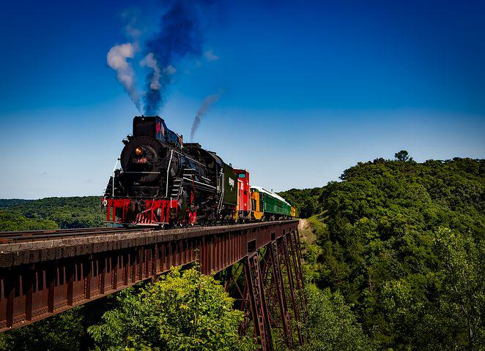
RAILWAY RESERVATION SYSTEM
MOHAN RAJA
NIDHI N
SUPRIYA V R
SIDDHARTH SHEKHAR
TEJA
MALLIKARJUN
SHIVAPRIYA
CHAND
PURUSHOTTAM
HIMANSHU

Slide 2
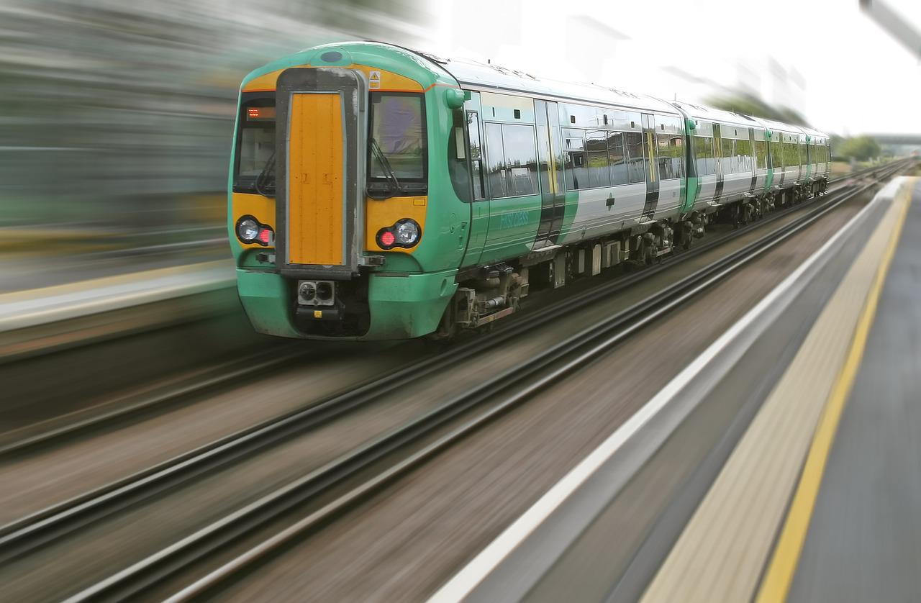



CONTENTS
PROJECT INFO
HOME PAGE
ADMIN LOGIN PAGE
SIGNUP USER PAGE
USER LOGIN PAGE

Slide 3

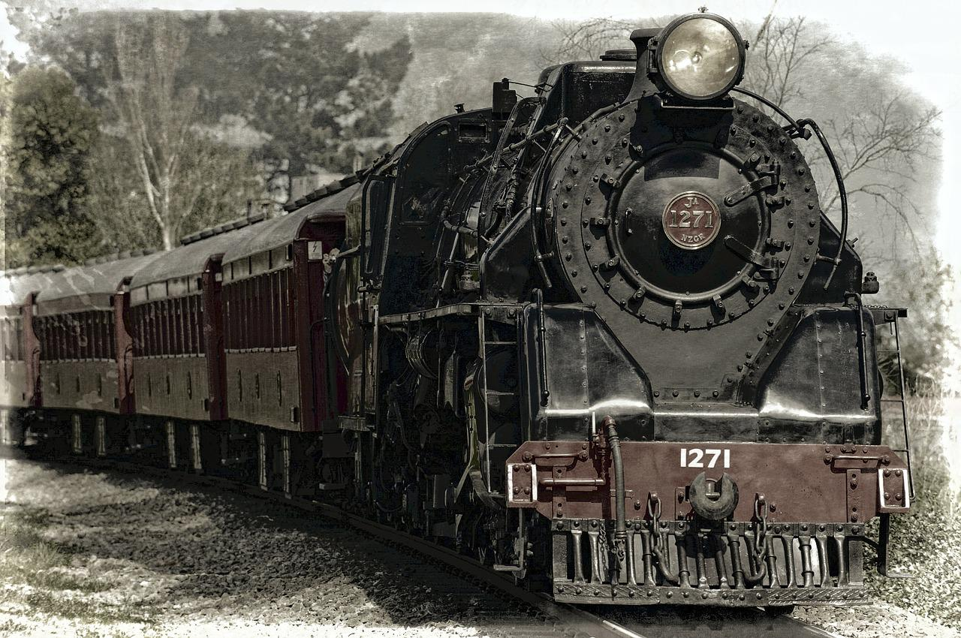



PROJECT INFO
The Railway Reservation System facilitates the passengers to enquiry about the trains available on the basis of source and destination, booking and cancellation of tickets, enquiry about the status of the booked ticket, etc..

Slide 4
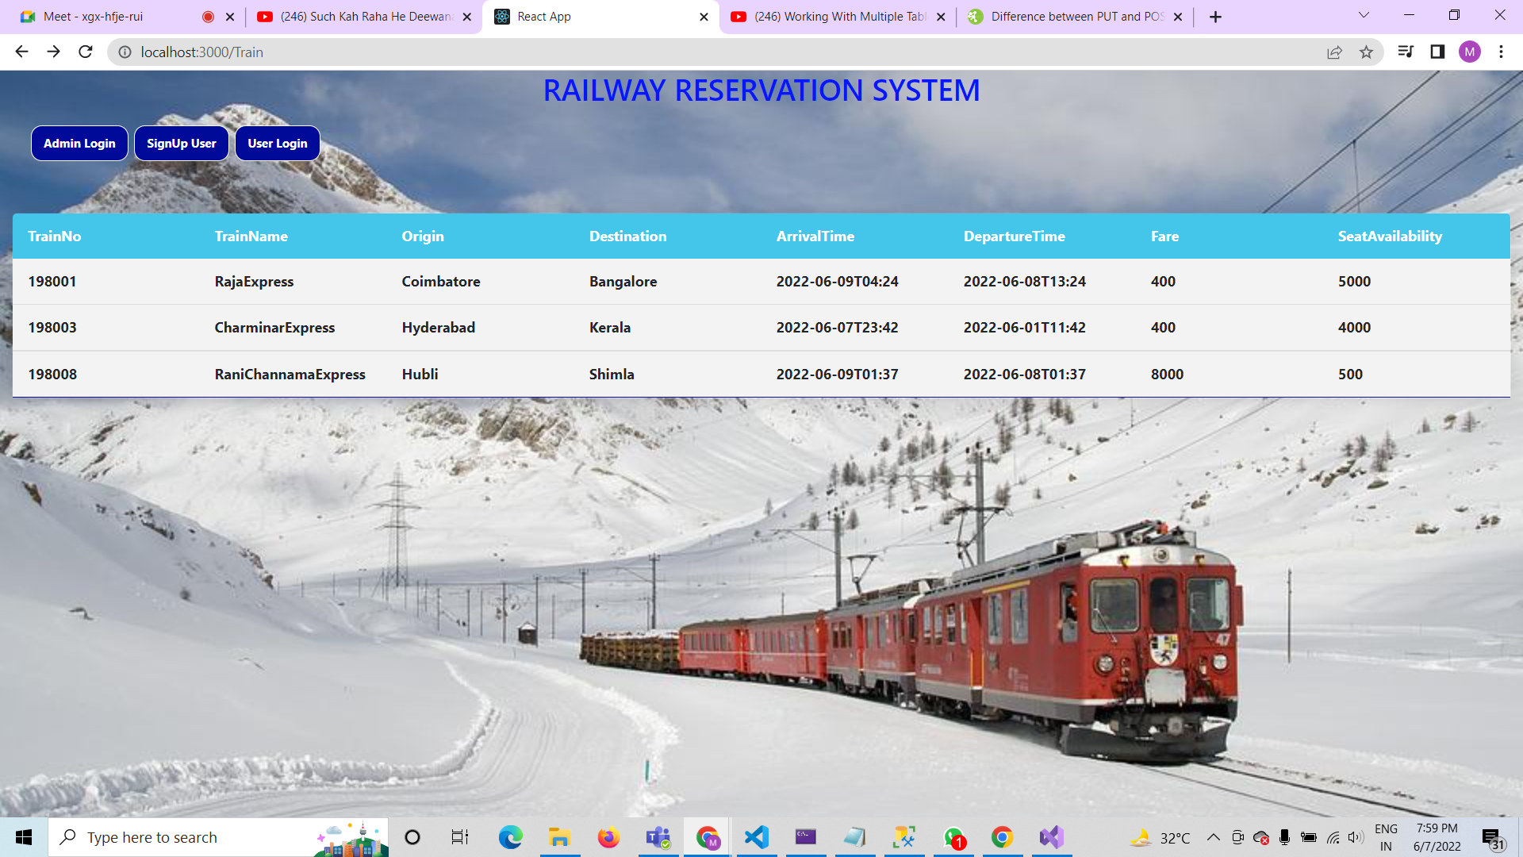
HOME PAGE

Slide 5
HOME PAGE
This is the Home page of our Railway Reservation System
its consists of Train Journey Details and three buttons like
ADMIN LOGIN
SIGNUP USER
User LOGIN

Slide 6
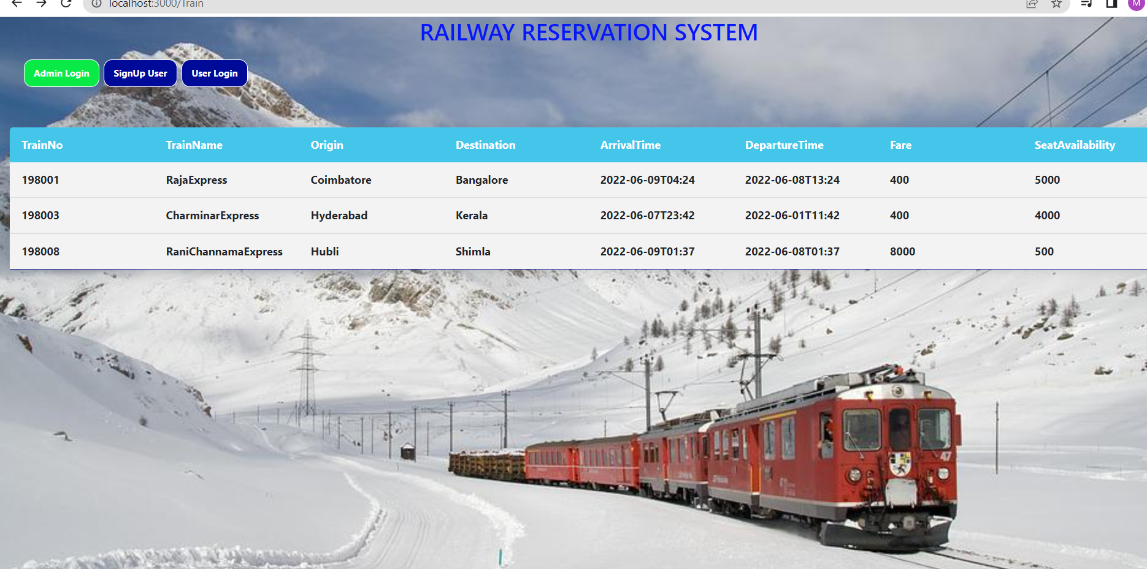
ADMIN LOGIN PAGE

Slide 7
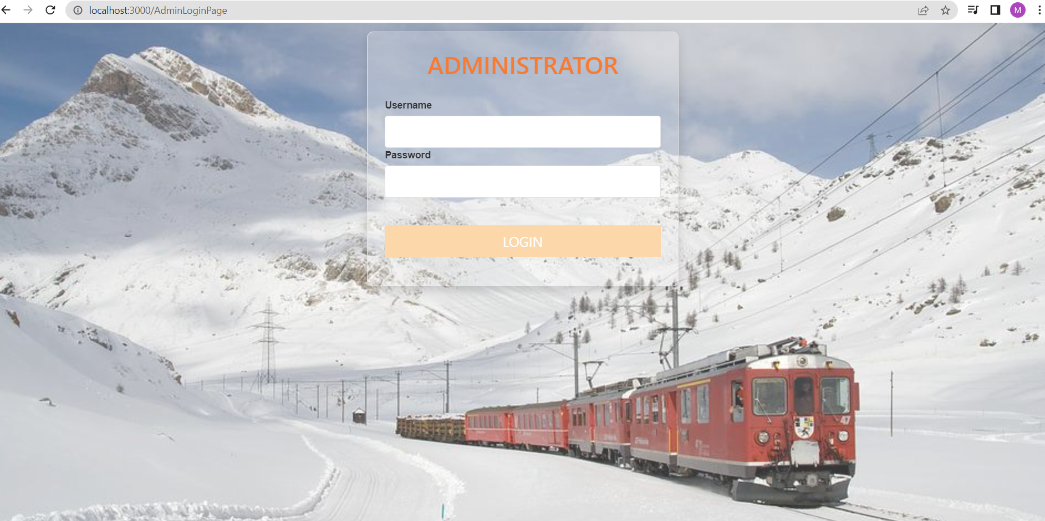
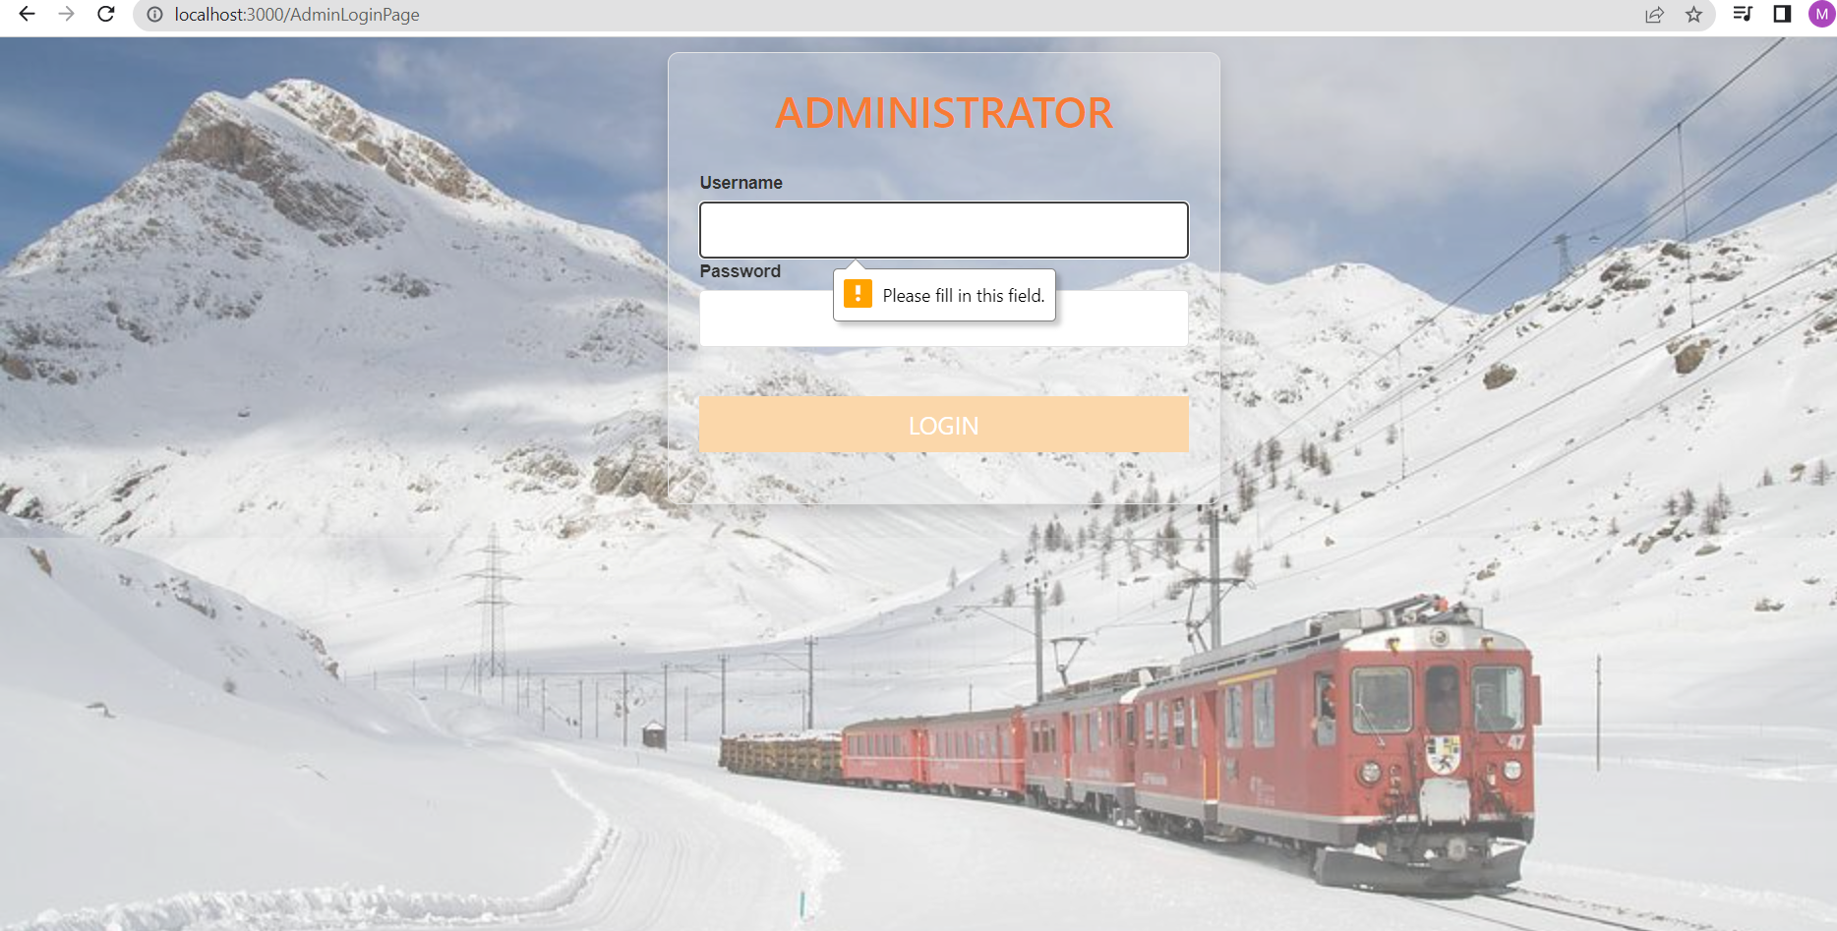
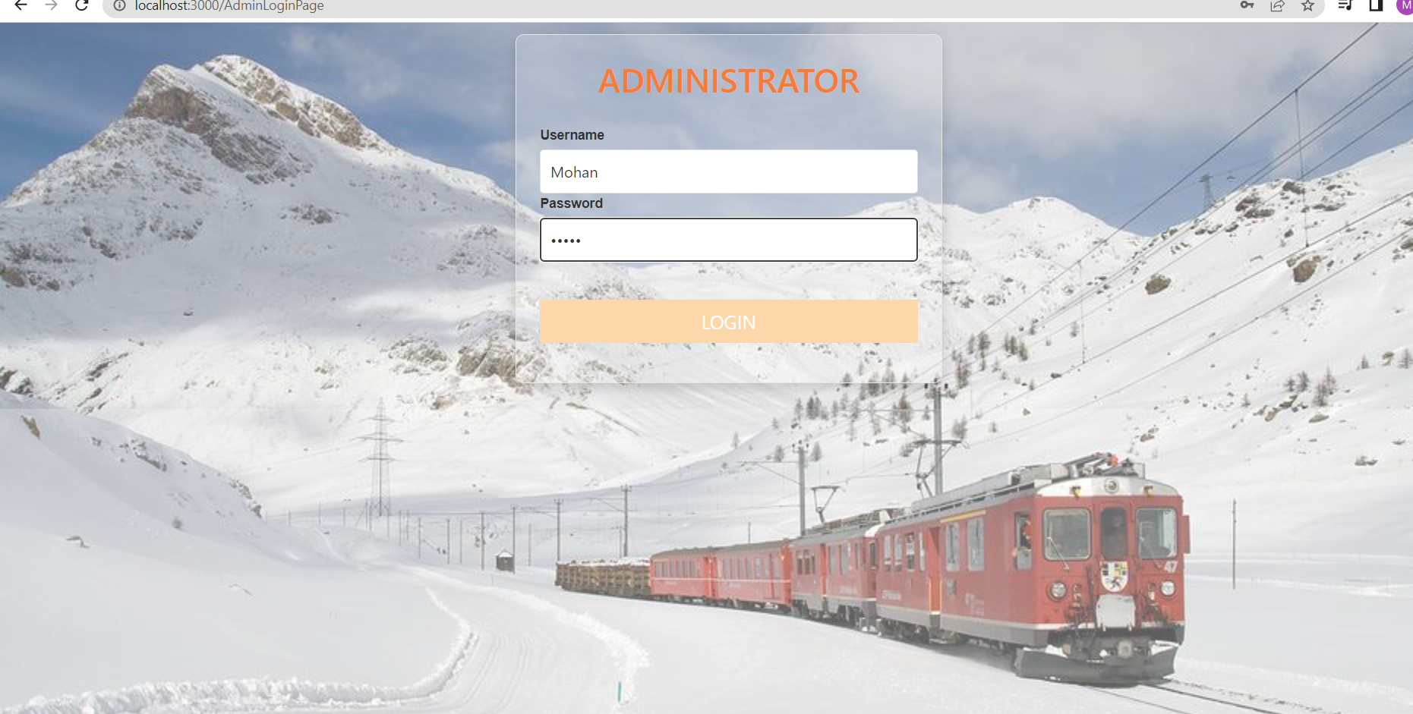
ADMINI LOGIN PAGE
ONCLICK ON ADMIN LOGIN BUTTON
WITHOUT USERNAME AND PASSWORD, IT WILL NOT VALIDATE LOGIN…!
AFTER GIVING VALID USERNAME AND PASSWORD IT WILL VALIDATE TO LOGIN PAGE

Slide 8
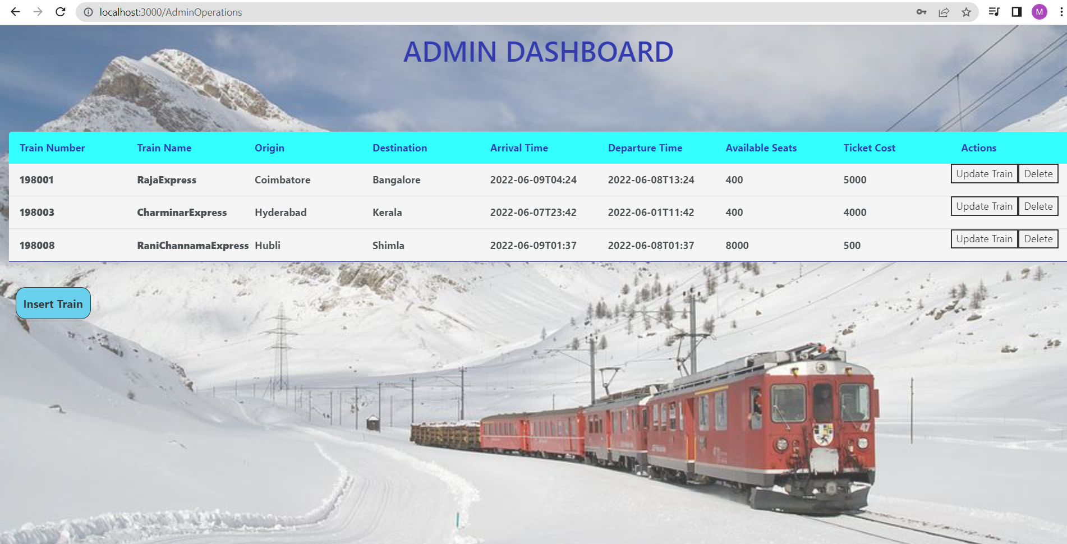
This page consists of Train data where Administrator can update , delete and insert
This page has two buttons in actions field
Insert Button:-Where we can Add new Train data
Update Train button:-Where we can change the existing train data
Delete Button:-Where we can delete existing train data

Slide 9
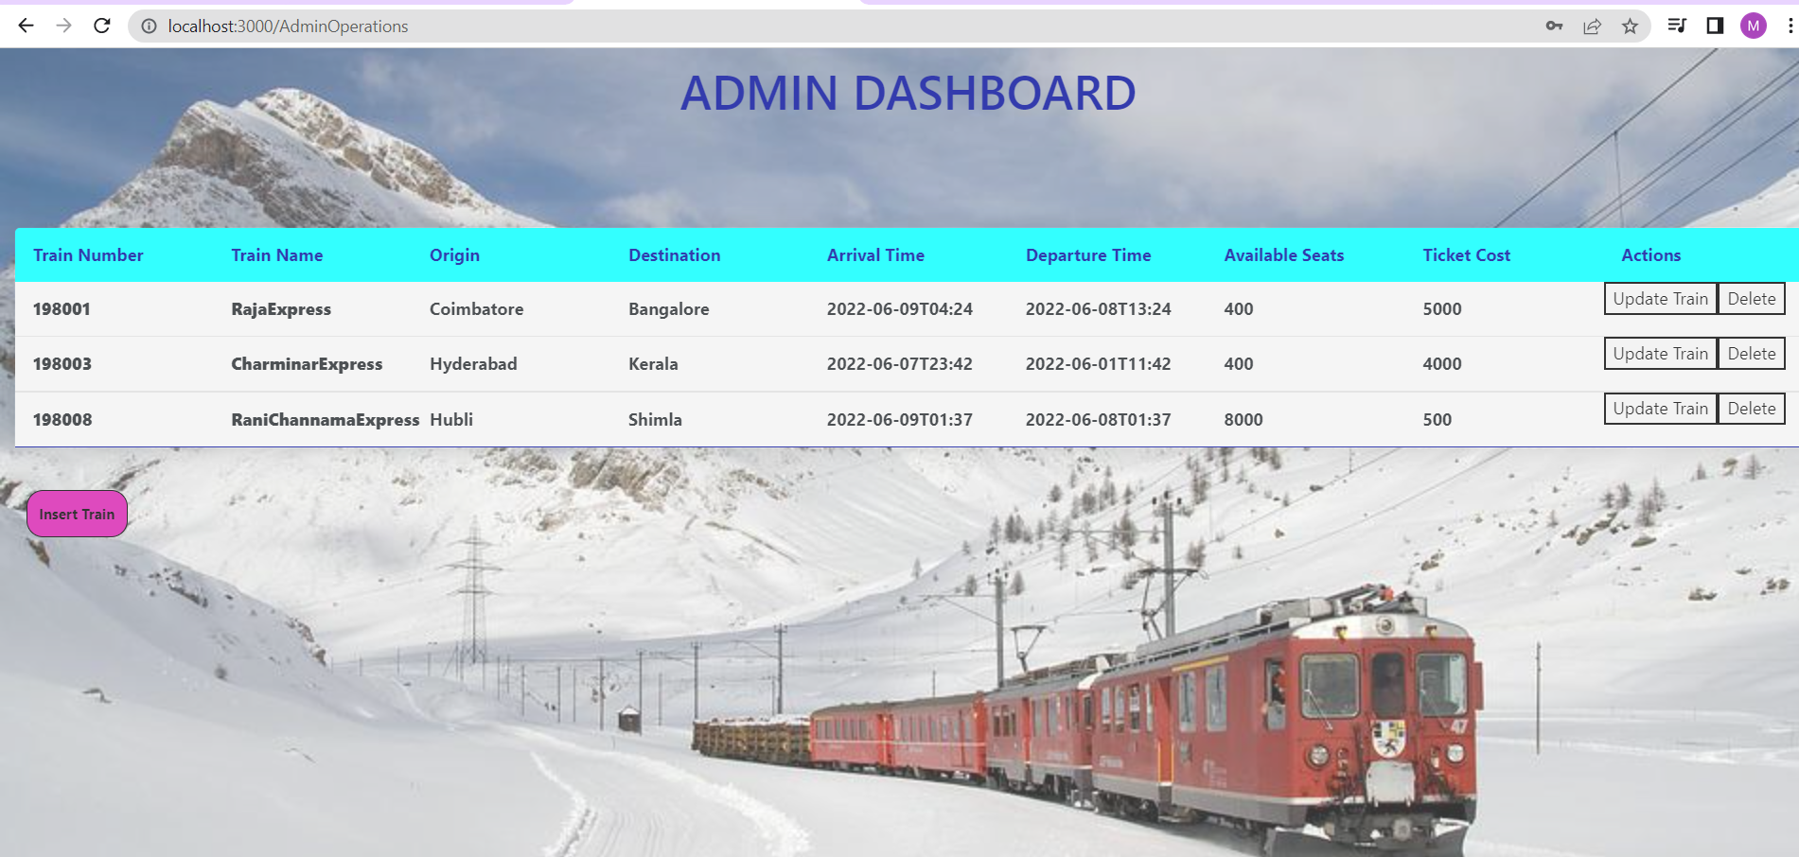
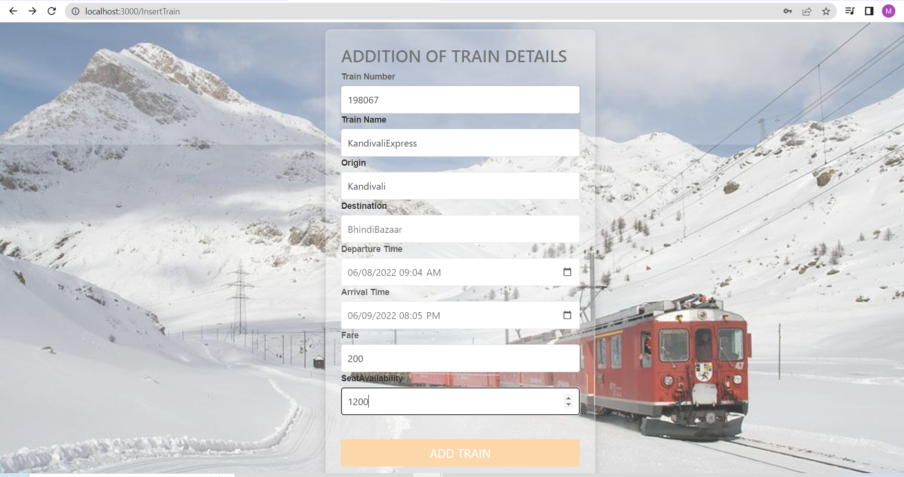
On click on Insert Train Button it will navigate to Addition of Train Details Page ,Where its consists of Train number , Train Name ,Origin ,Destination, Departure Time , Arrival Time, Fare , Seat Availability then it will validate to adding train details on Train data

Slide 10
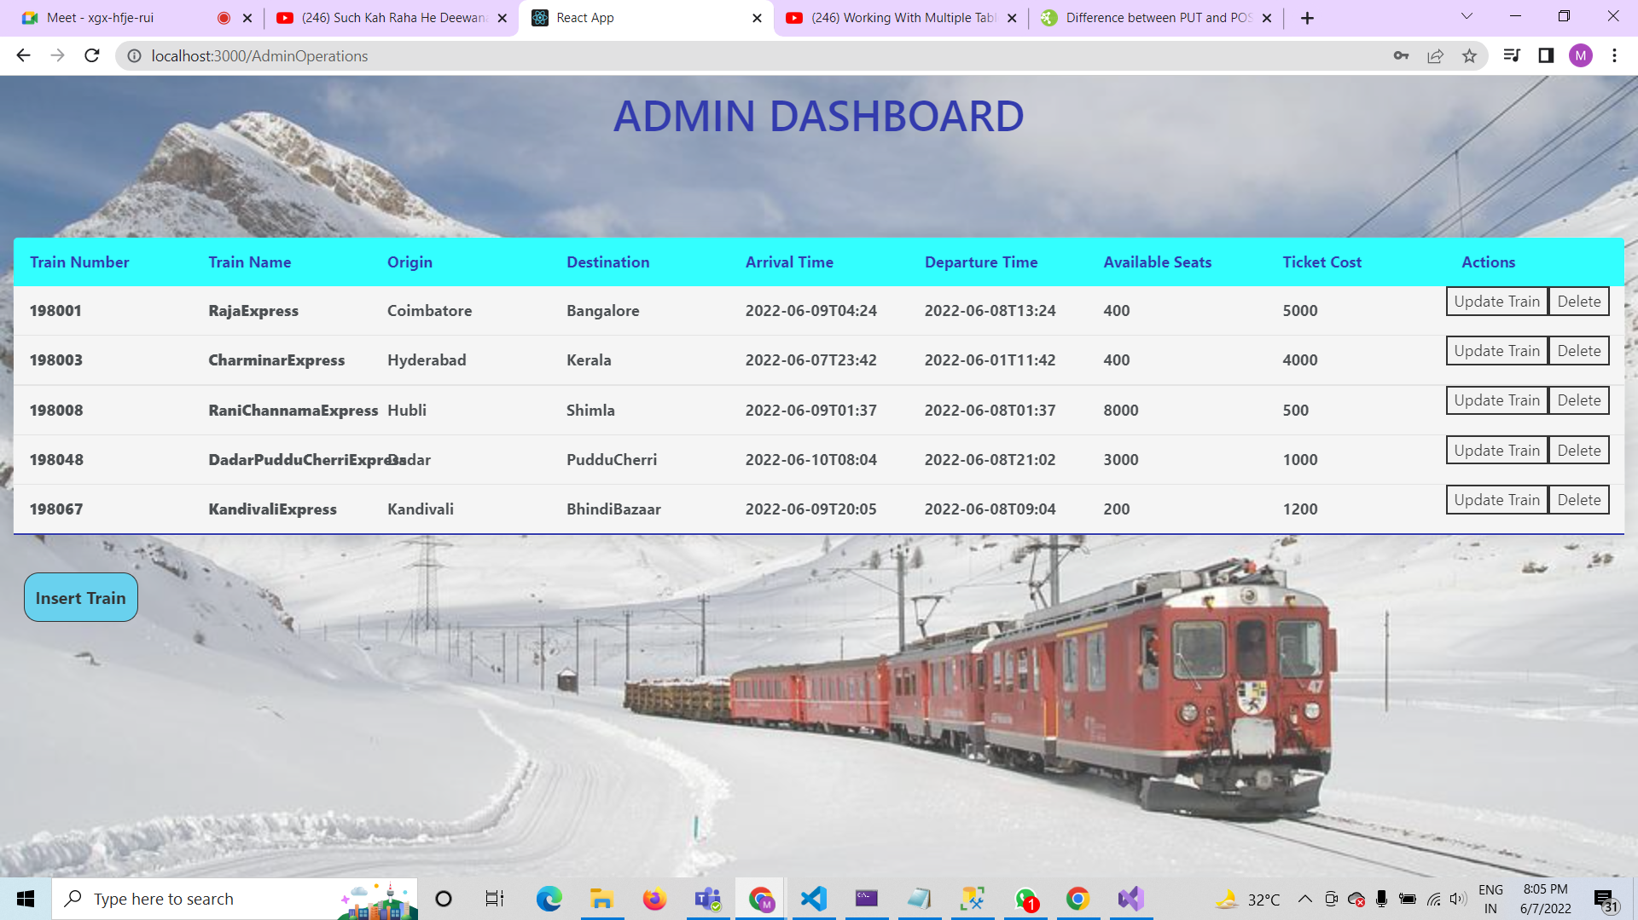
After Inserting of new Train data
In this page of train details we have inserted two train data with train names DadarPudduCherriExpress and Kandivali Express

Slide 11
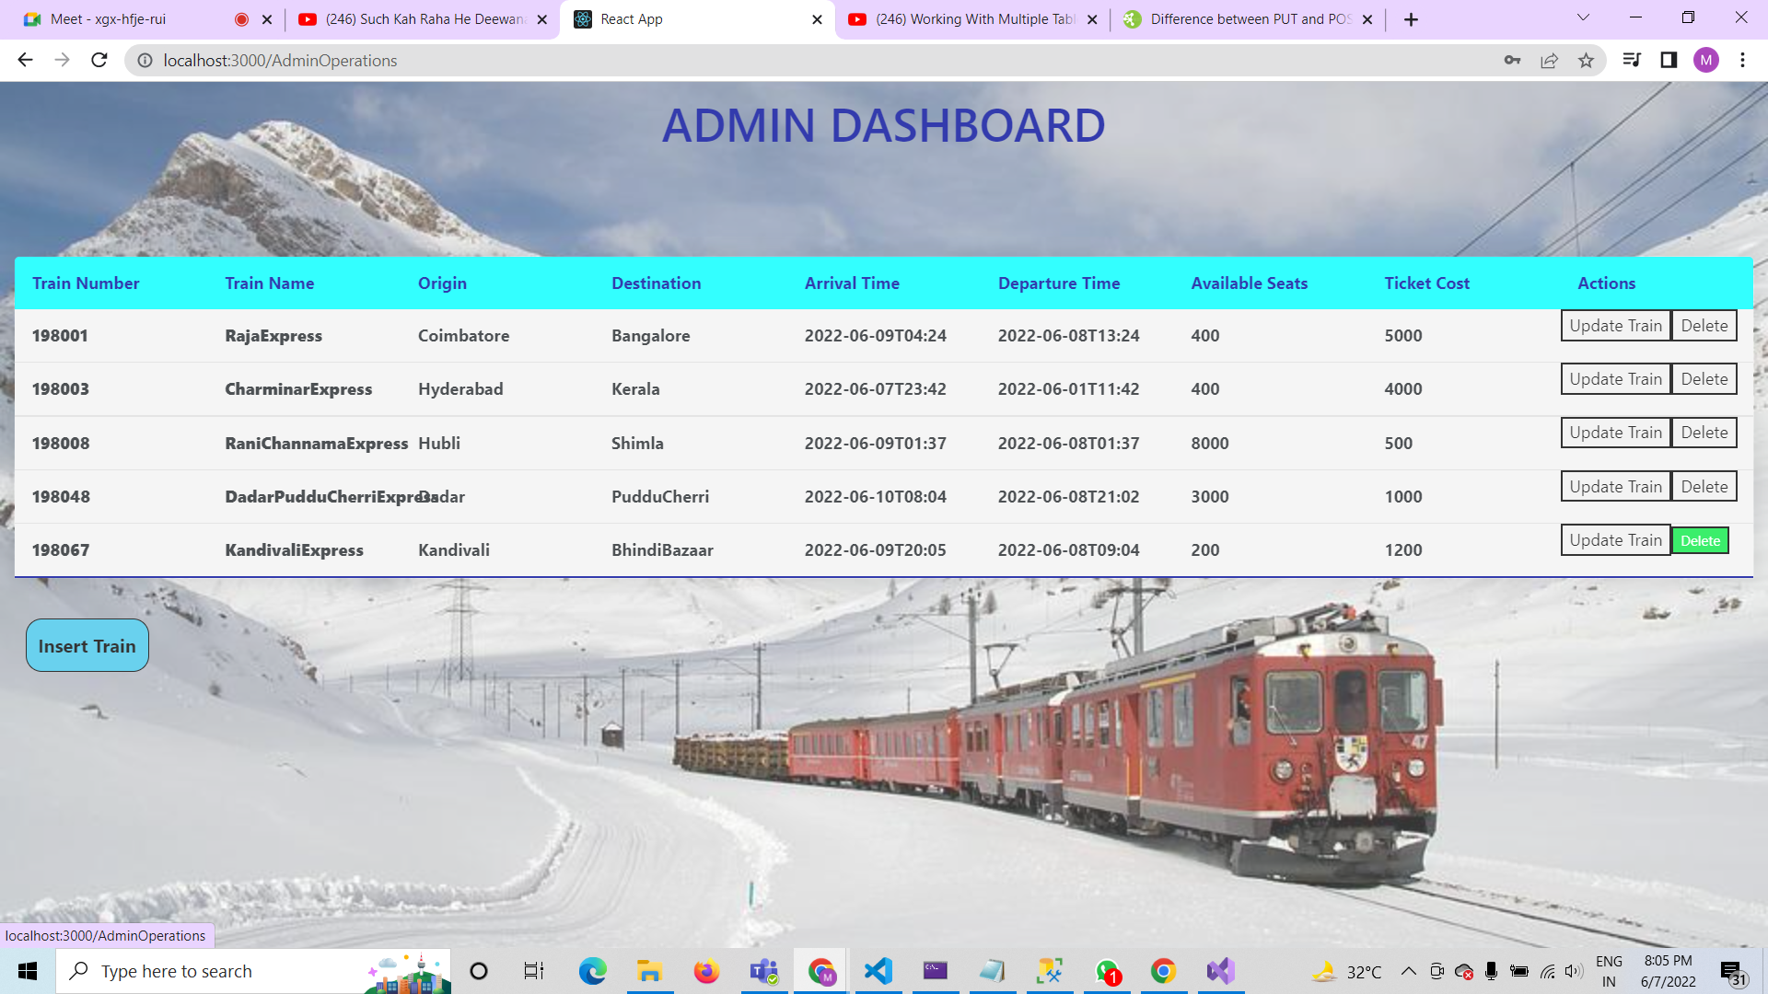
Deleting Of Train Data
Here by on clicking on delete button we are deleting one of the train data where in the above pic we are deleting that train with the name “KandavalliExpress”.

Slide 12
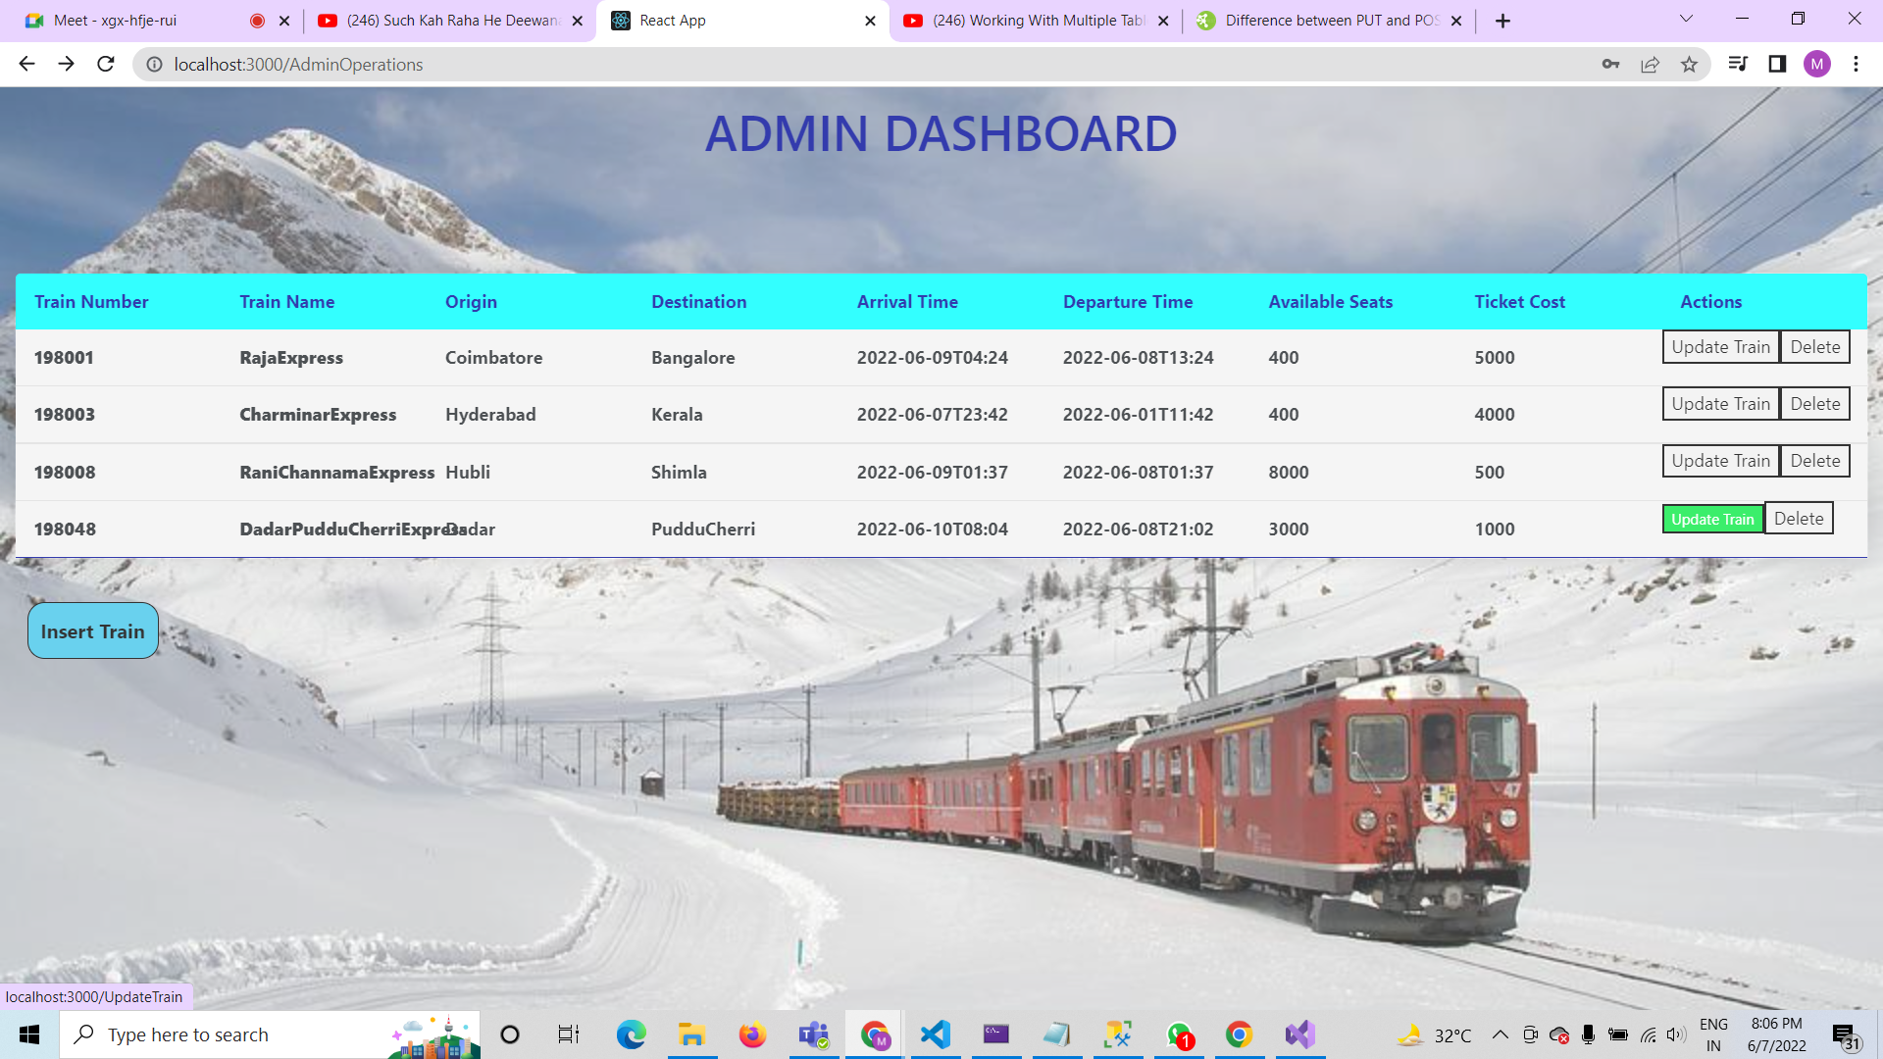
Update Train Data

Slide 13
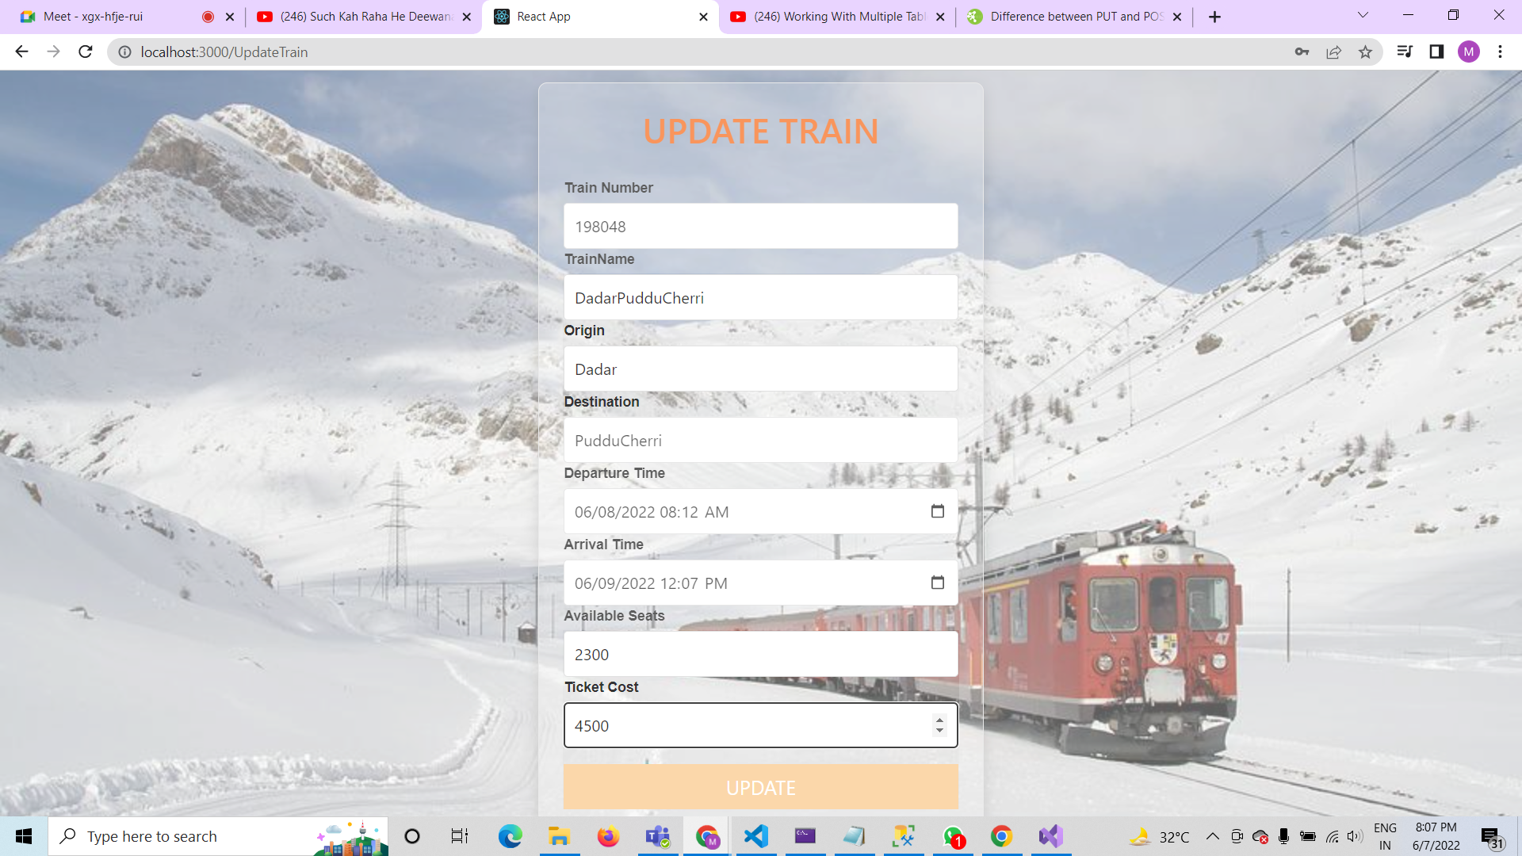
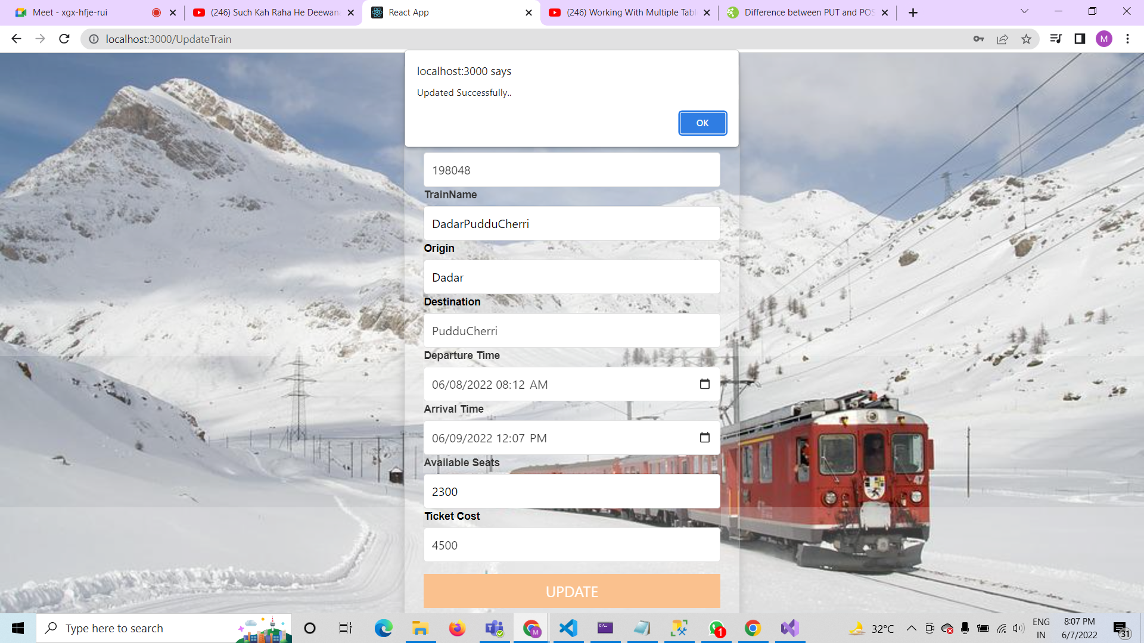
Updating Train
In this page we are giving new data to updating Existing Train data.
In this its validating Updated Train data and shows in Train Info

Slide 14
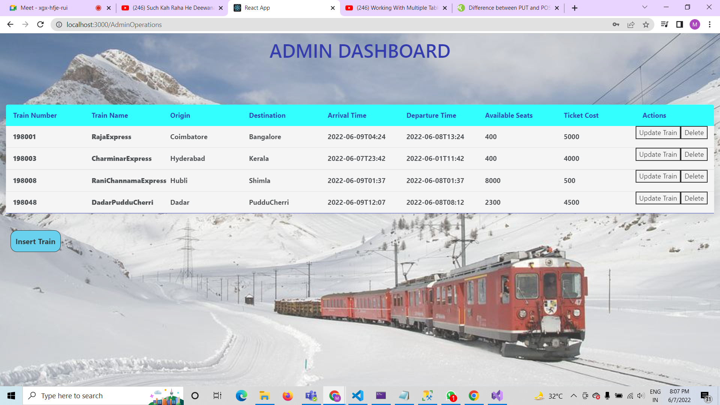
In this page we are updated the whole Train data from old train name with new data consisting of “DadarPudducheri”……

Slide 15
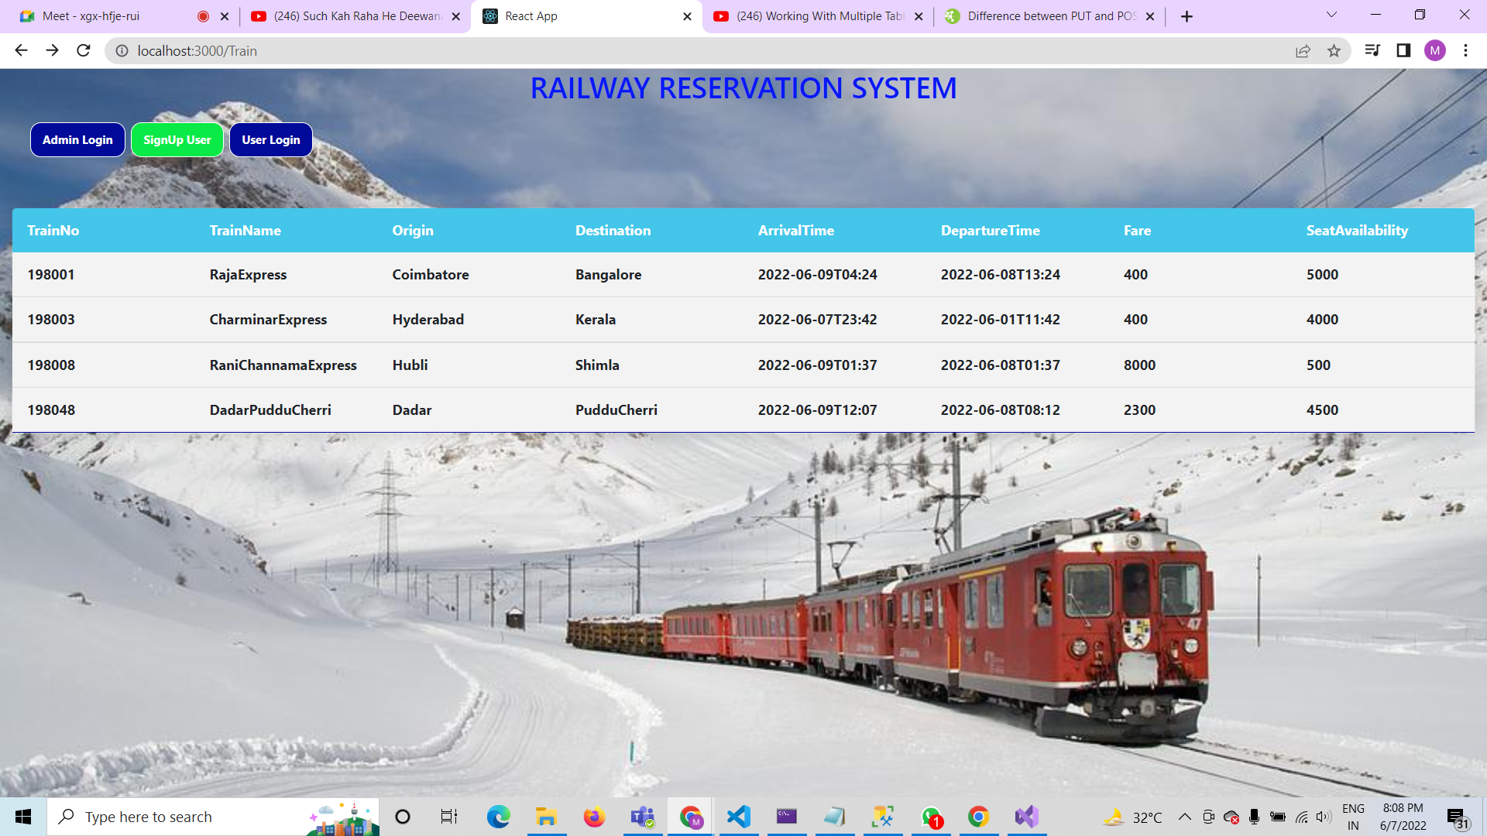
Signup User Page

Slide 16
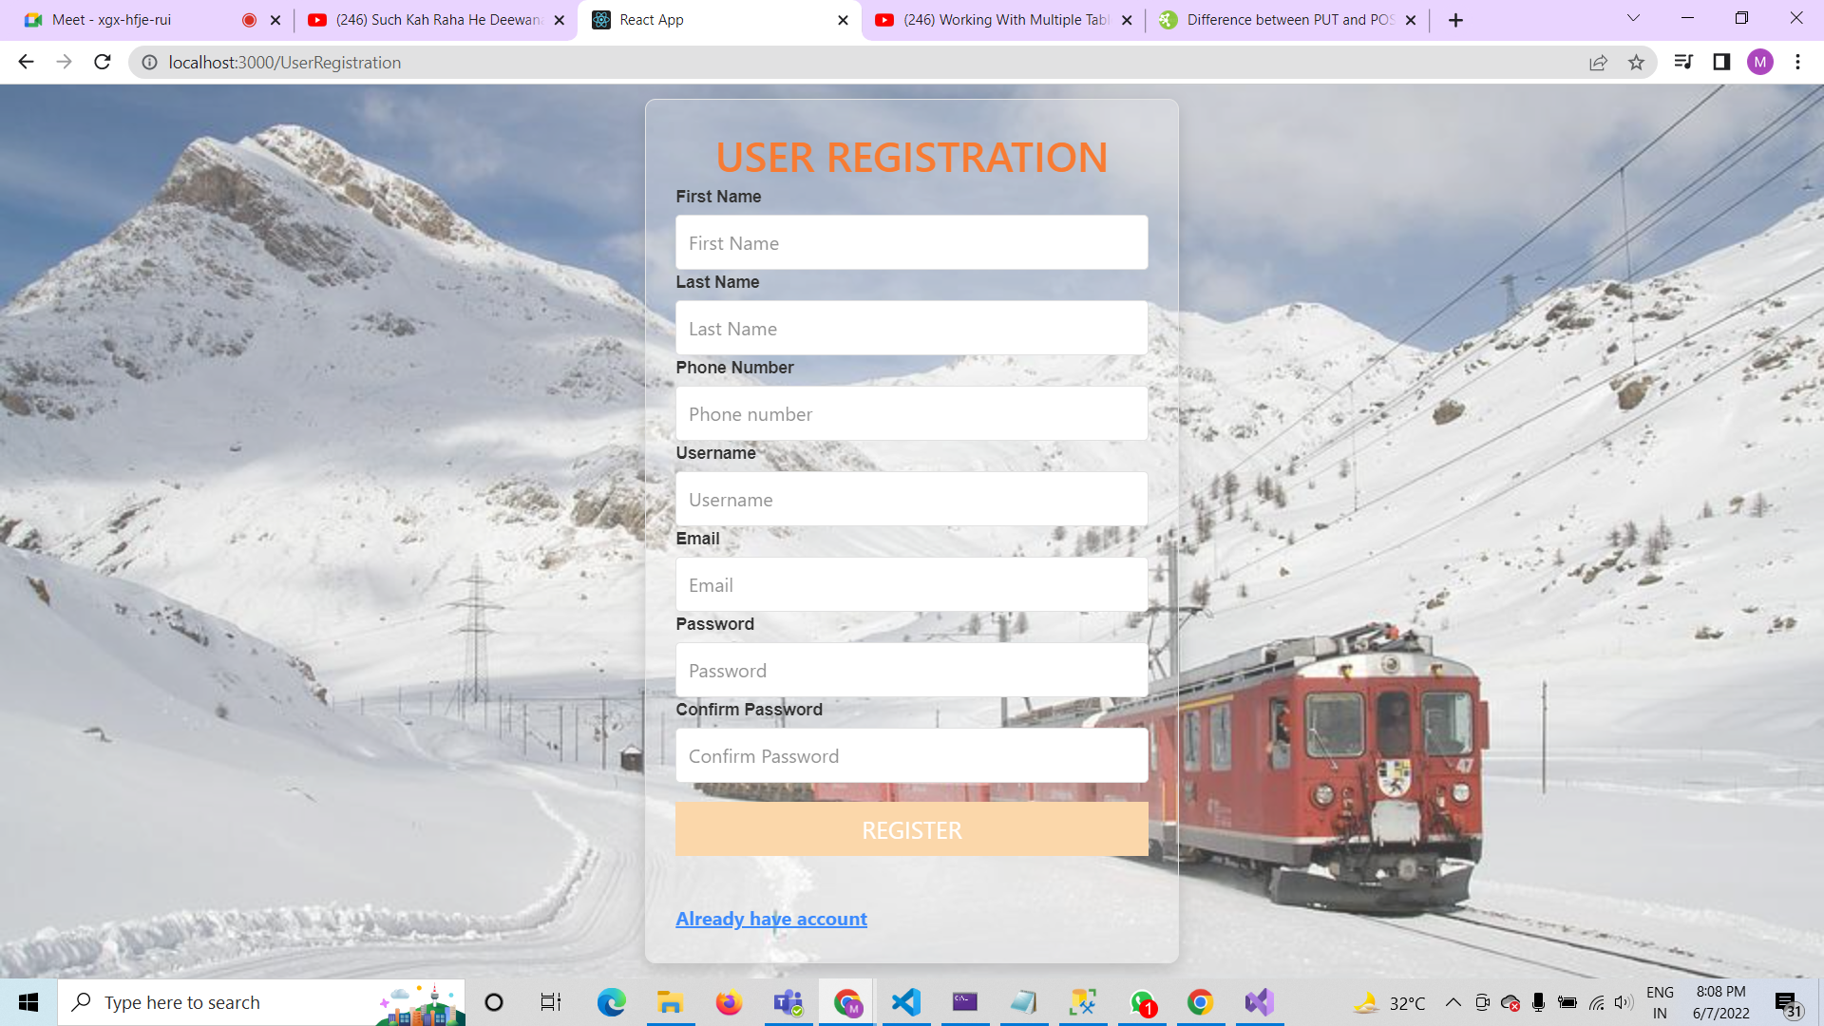
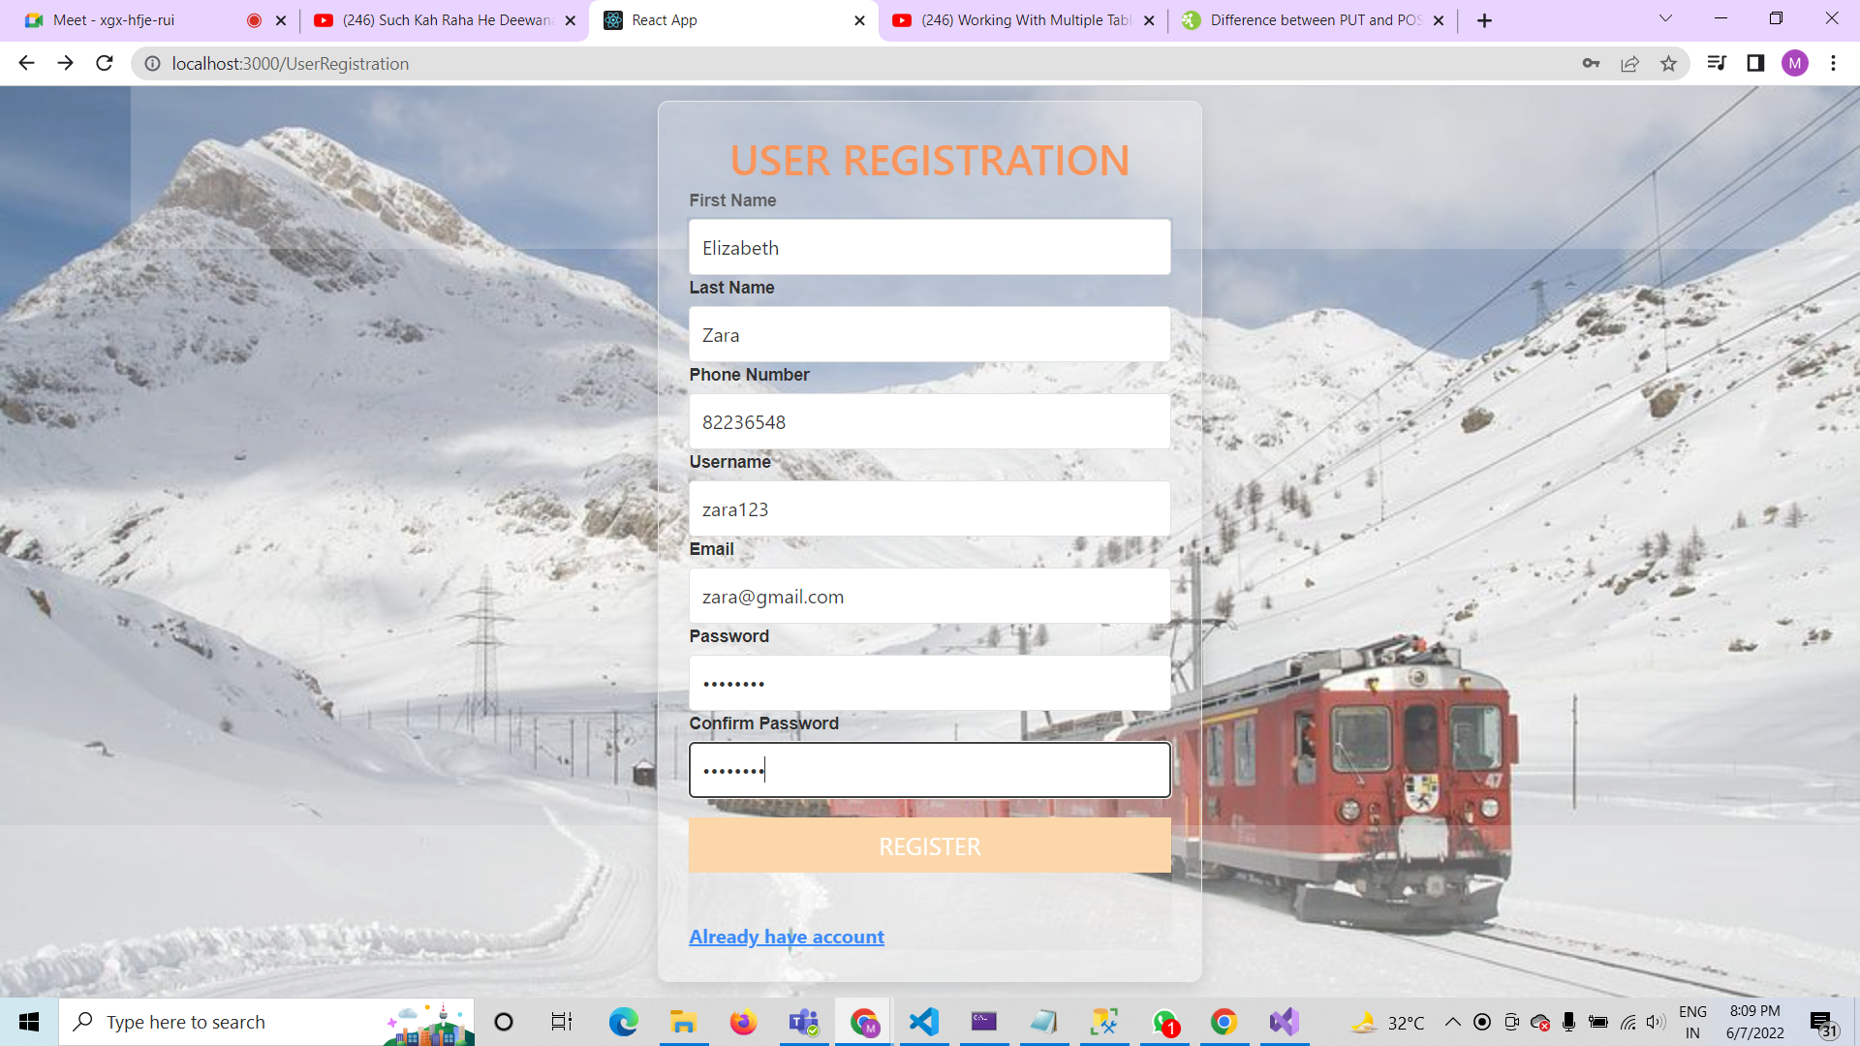
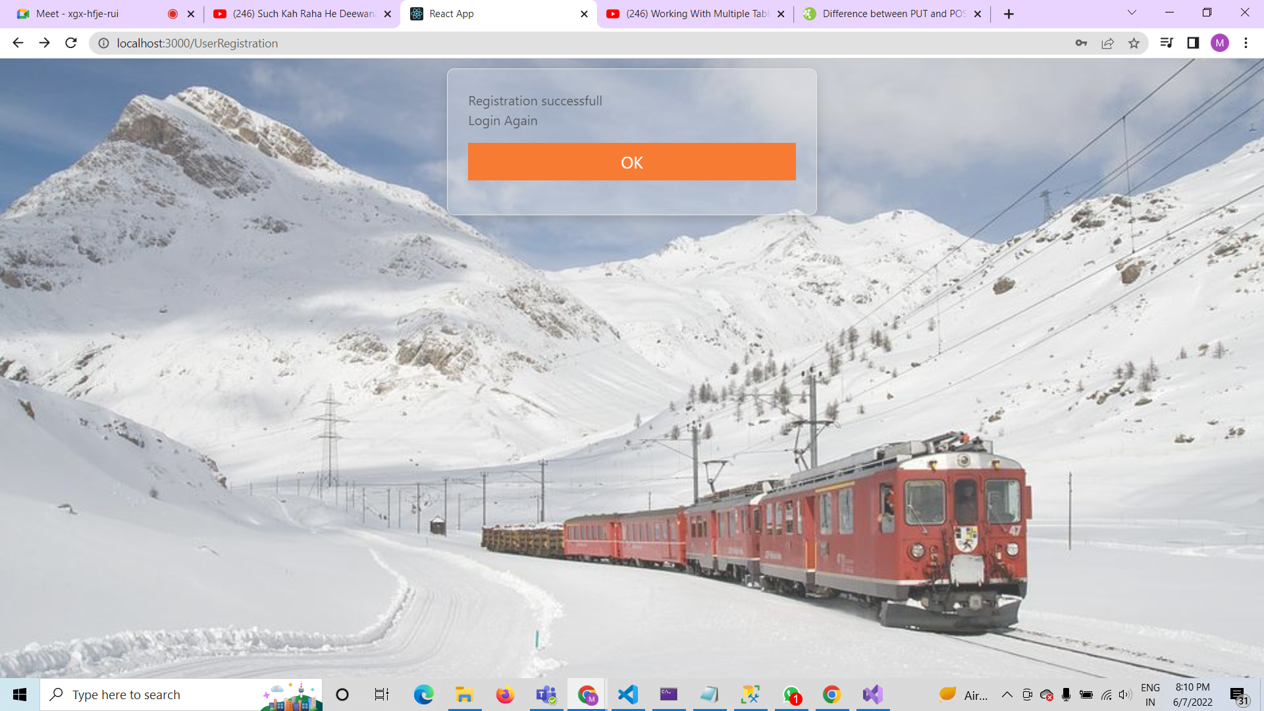
On click on Sign up user button it will navigate to the
USER REGISTARATION page After giving valid user details
It will validate the register of the user And asks for login
from the user login button.

Slide 17
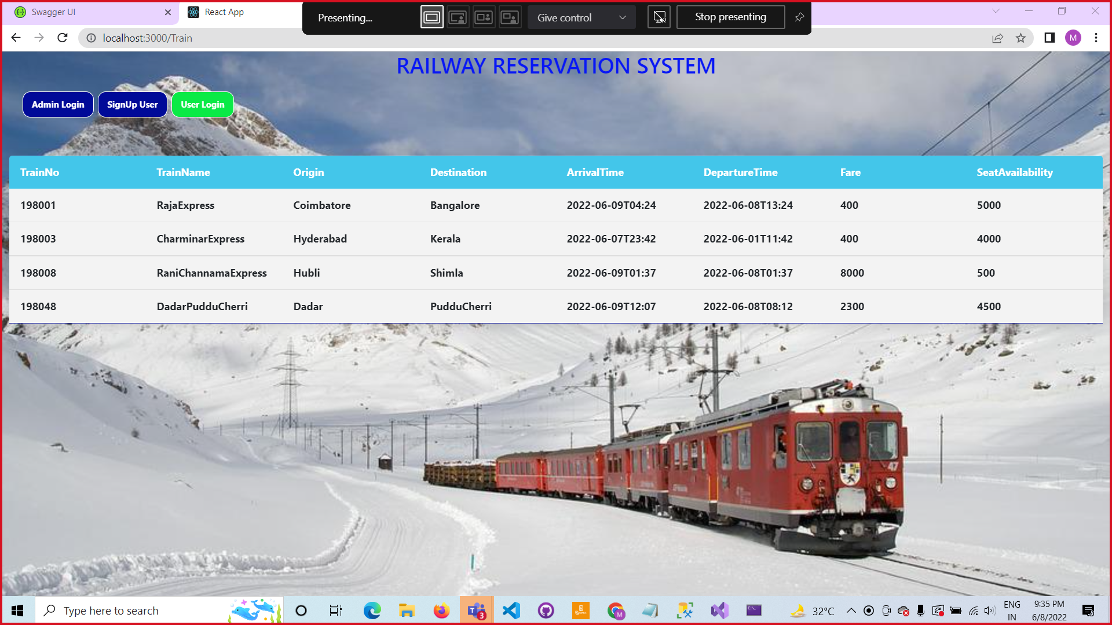
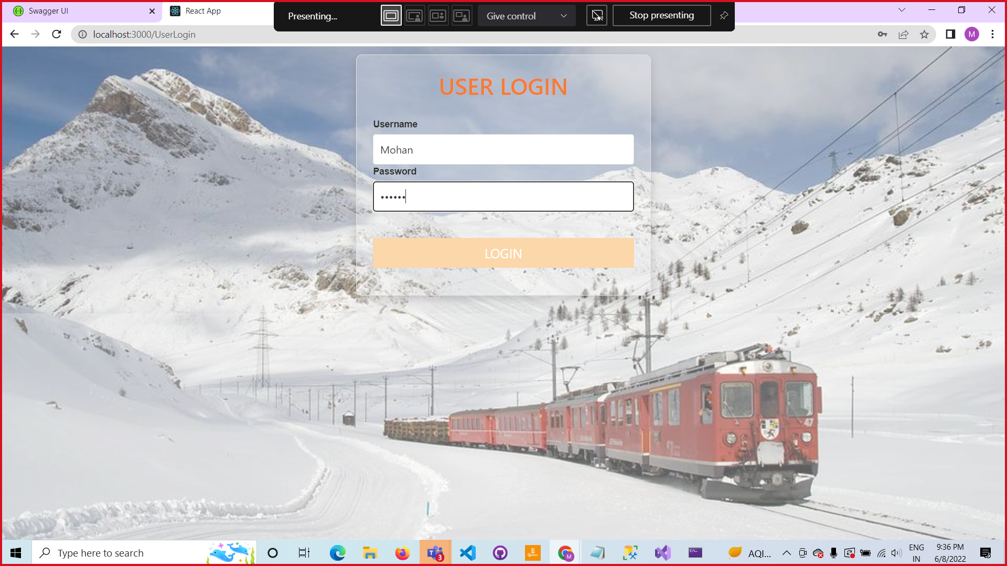
USER LOGIN PAGE
On click on USER LOGIN button it will navigate to USER LOGIN page as shown in the above pics , Where we will login with validate username and password then it validates to access data.

Slide 18
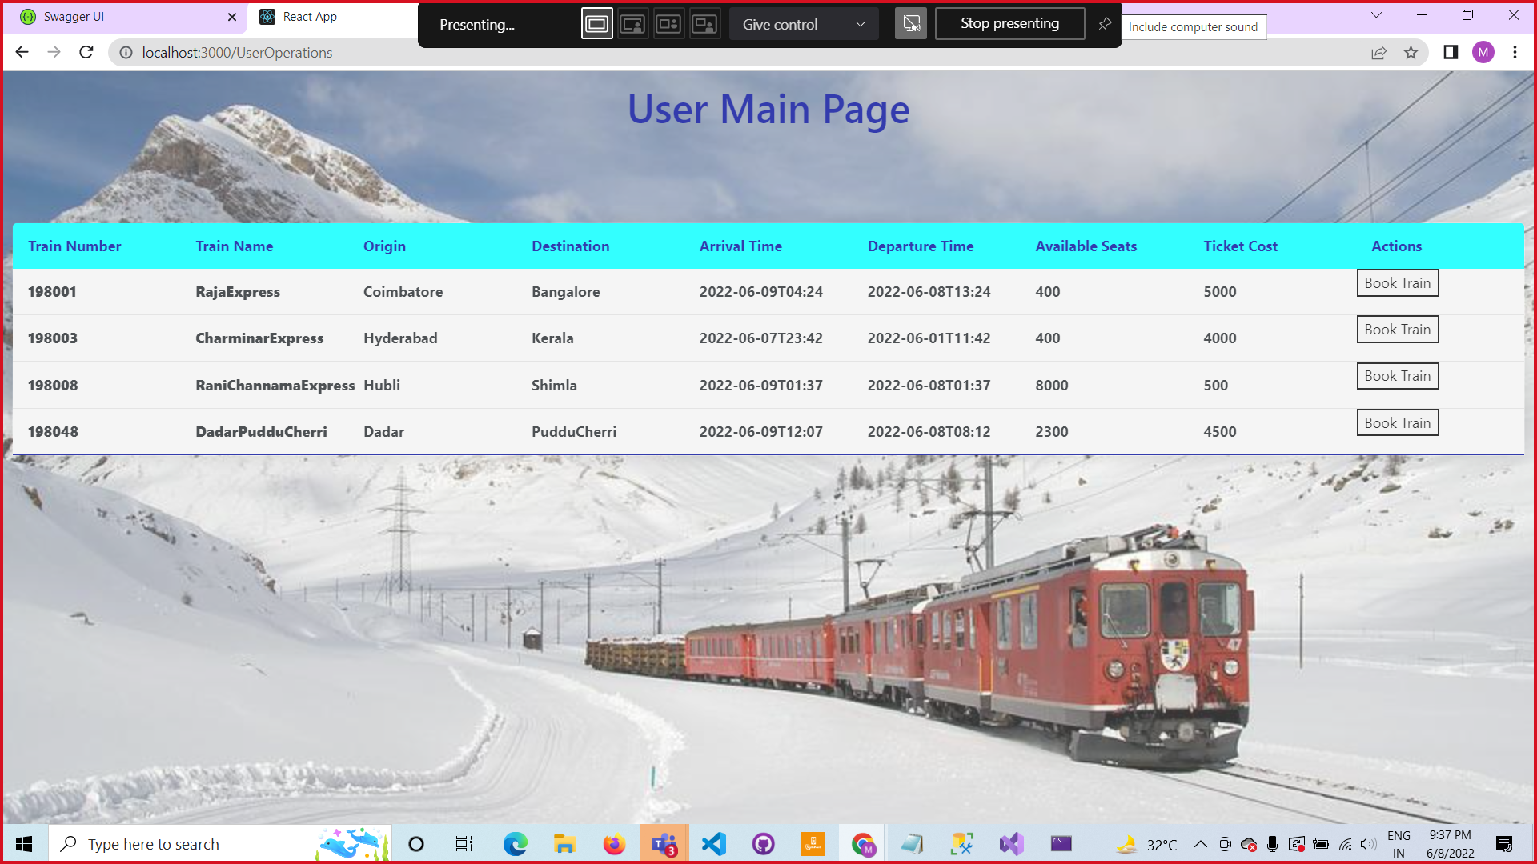

After the login validation done, it will navigate to USER MAIN page where it consists of Train Data from where user can book a train ticket using Book Train button as shown in above pic..

